Slide 1
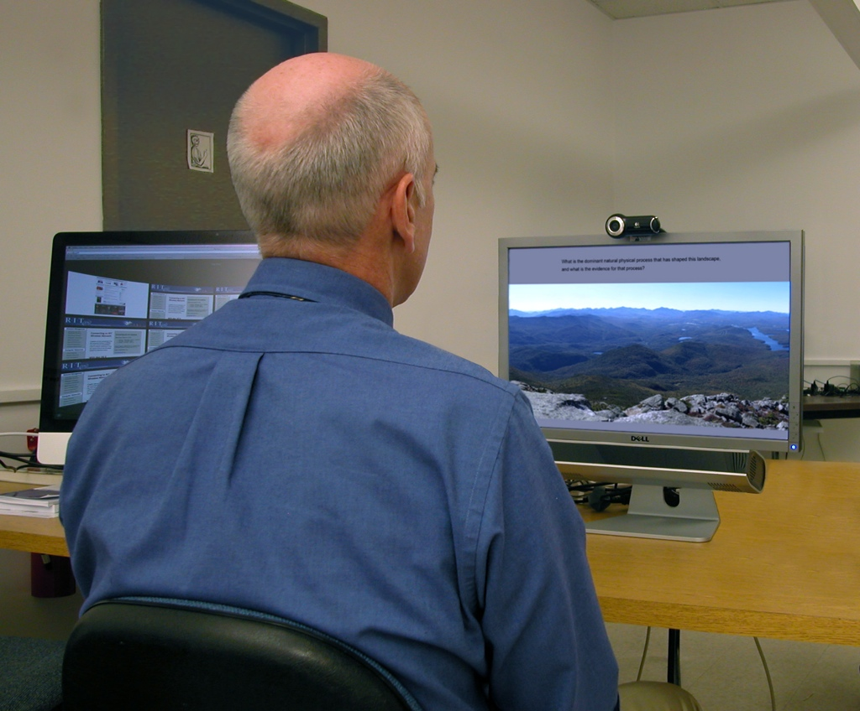
Analyzing lab-based gaze data

Slide 2
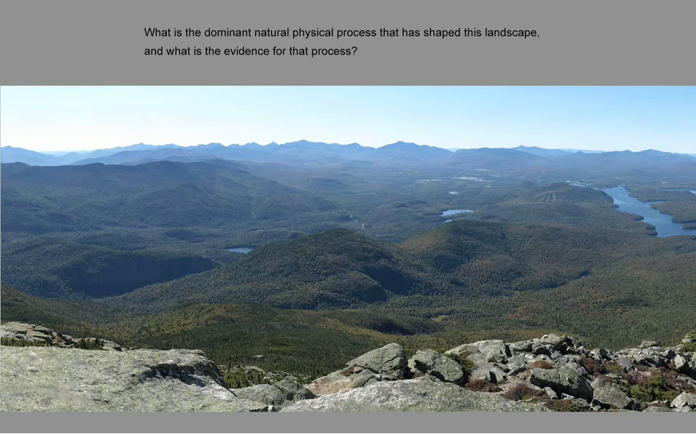
Analyzing Video-based Gaze Data

Slide 3
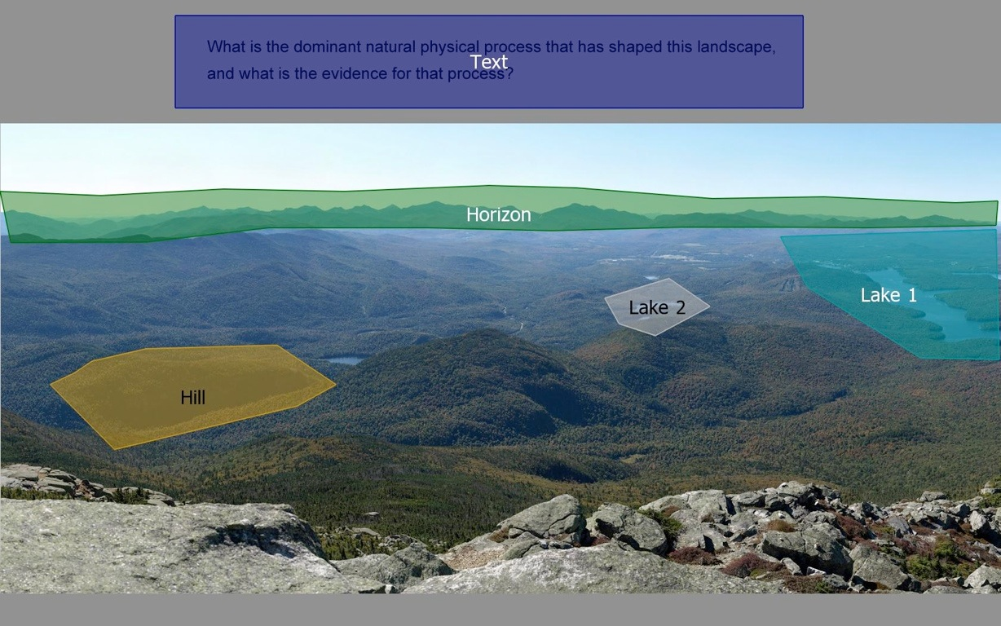
Analyzing Video-based Gaze Data
Define Areas of Interest (AOIs)

Slide 4
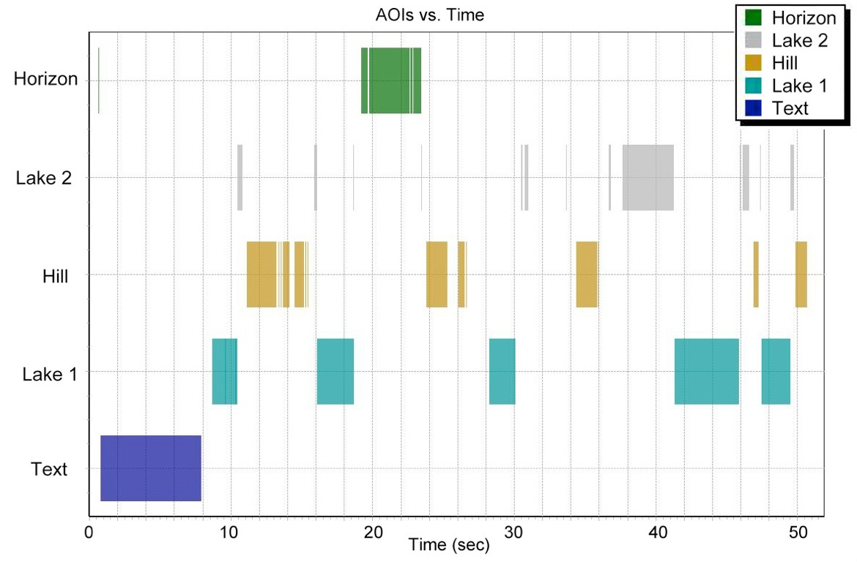
Analyzing Video-based Gaze Data

Slide 5
Analyzing Video-based Gaze Data
Sequence: 1
Entry time: 0.250
Dwell time: 8.187
Hit ratio: 1.00
Revisits: 0.45
Average fixation: 0.243
First fixation: 0.285
Fixation count: 23.66
Sequence: 2
Entry time: 0.250
Dwell time: 4.634
Hit ratio: 1.00
Revisits: 2.63
Average fixation: 0.217
First fixation: 0.385
Fixation count: 14.76
Sequence: 4
Entry time: 10.650
Dwell time: 6.104
Hit ratio: 0.66
Revisits: 0.83
Average fixation: 0.608
First fixation: .505
Fixation count: 10.87
Sequence: 3
Entry time: 8.437
Dwell time: 14.323
Hit ratio: 1.00
Revisits: 4.63
Average fixation: 0.414
First fixation: .265
Fixation count: 9.12
Sequence: 5
Entry time: 11.845
Dwell time: 5.488
Hit ratio: 0.50
Revisits: 0.87
Average fixation: 0.408
First fixation: .505
Fixation count: 12.84

